Slide 1
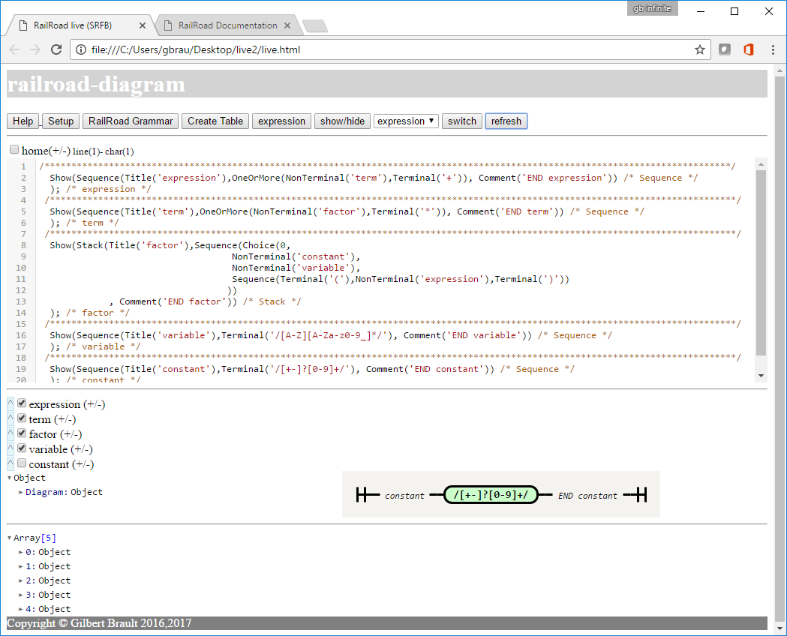
Show/Hide unchecked
Diagrams
a
Banner
1
b
Help
Navigation
2
c
Set Parameters
Select
Grammars
Or default
associated expression
d
Grammar
Editor
3
e
Select grammar expression type to validate
f
Switch from grammar to expression editor
Tree &
Syntax Diagram
4
g
Refresh or
Validate (expression)
Input
Show/Hide (checked = item hidden)
Result
Show/Hide tree node
EBNF
5
Navigation
Structure
Footer
6

Slide 2
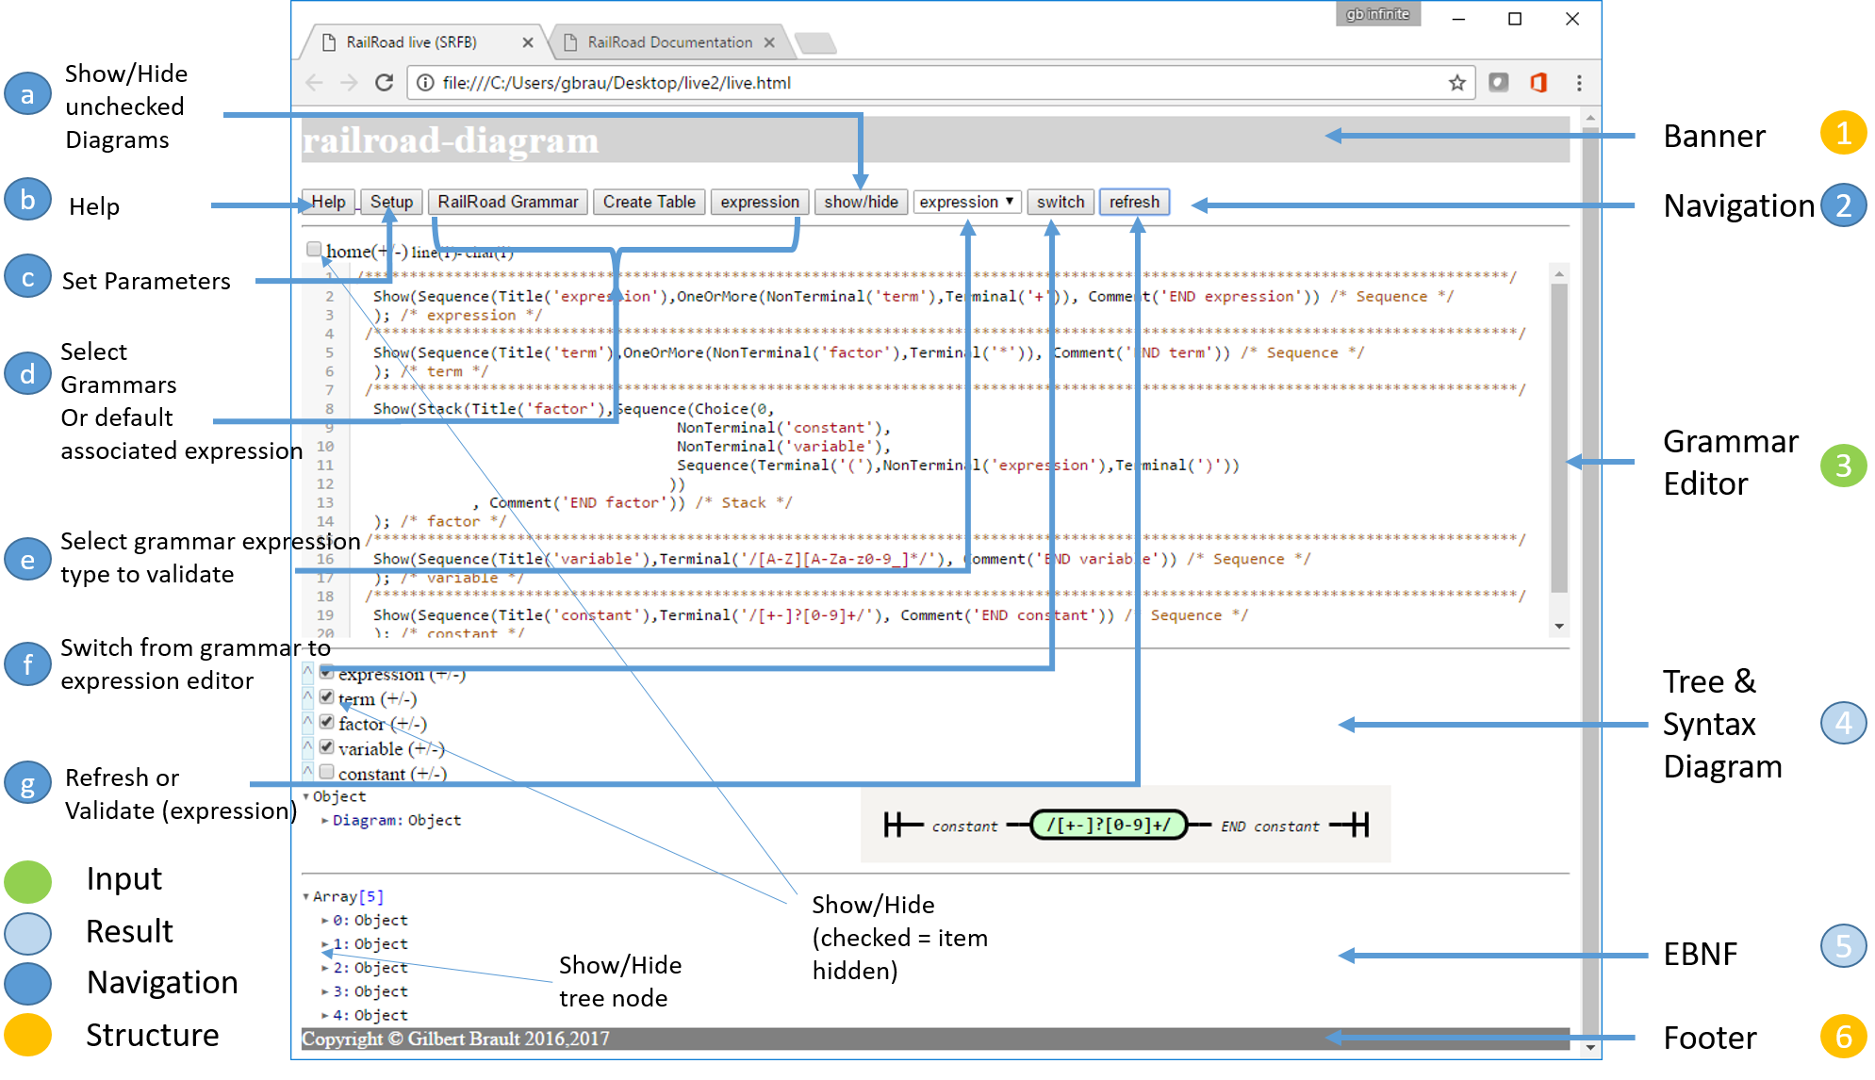

Slide 3
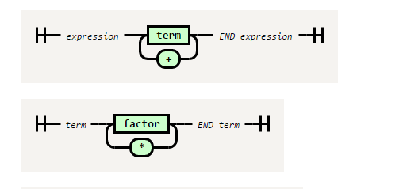
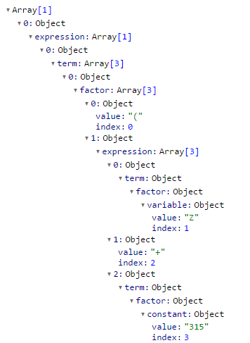
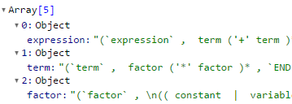
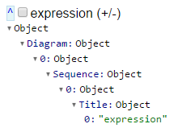
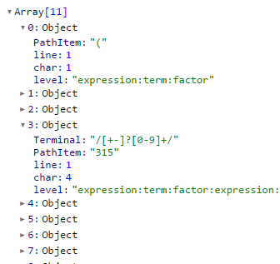
Grammar
transformation
Expression
validation
refresh
validate
Syntax
graph
Tokenized
expression
Diagram
Sequence
Stack
Choice
Optional
OneOrMore
ZeroOrMore
Terminal
NonTerminal
Comment
Skip
EBNF
SRFB
Grammar
{validating:”tree”}
Tree
Walker
Tree
{validating:”function”}
function RR_constant = Diagram.bind(this,
Sequence.bind(this, Title.bind(this, "constant"),
Terminal.bind(this, "/[+-]?[0-9]+/"),
Comment.bind(this, "END constant")
)
);
function RR_expression = Diagram.bind(this,
…
Validating
function
Generating
Diagram
Sequence
Stack
Choice
Optional
OneOrMore
ZeroOrMore
Terminal
NonTerminal
Comment
Skip

Slide 4
function RR_constant = Diagram.bind(this,
Sequence.bind(this, Title.bind(this, "constant"),
Terminal.bind(this, "/[+-]?[0-9]+/"),
Comment.bind(this, "END constant")
)
);
function RR_expression = Diagram.bind(this,
Sequence.bind(this,
Title.bind(this, "expression"),
OneOrMore.bind(this,
NonTerminal.bind(this, "term"),
Terminal.bind(this, "+")),
Comment.bind(this, "END expression")
)
);
function RR_factor = Diagram.bind(this,
Stack.bind(this,
Title.bind(this, "factor"),
Sequence.bind(this,
Choice.bind(this, 0,
NonTerminal.bind(this, "constant"),
NonTerminal.bind(this, "variable"),
Sequence.bind(this,
Terminal.bind(this, "("),
NonTerminal.bind(this, "expression"),
Terminal.bind(this, ")")
)
)
),
Comment.bind(this, "END factor")
)
);
function RR_term = Diagram.bind(this,
Sequence.bind(this,
Title.bind(this, "term"),
OneOrMore.bind(this,
NonTerminal.bind(this, "factor"),
Terminal.bind(this, "*")
),
Comment.bind(this, "END term")
)
);
function RR_variable = Diagram.bind(this,
Sequence.bind(this,
Title.bind(this, "variable"),
Terminal.bind(this, "/[A-Z][A-Za-z0-9_]*/"),
Comment.bind(this, "END variable")
)
);

